Slide 1
Revision

Slide 2
Greedy Algorithm

Slide 3
Interval Scheduling
Interval scheduling.
Job j starts at s_{j} and finishes at f_{j}.
Two jobs compatible if they don't overlap.
Goal: find maximum subset of mutually compatible jobs.
a
b
c
d
e
f
g
h
Time
0
1
2
3
4
5
6
7
8
9
10
11
Notes:
Activity selection = interval scheduling
OPT = B, E, H
Note: smallest job (C) is not in any optimal solution, job that starts first (A) is not in any optimal solution.

Slide 4
Interval Scheduling: Greedy Algorithm
Greedy algorithm. Consider jobs in increasing order of finishing time. Take each job provided it's compatible with the ones already taken.
Implementation. O(n log n).
Sort jobs by finish times so that f₁ ≤ f₂ ≤ ... ≤ f_{n}.
A ← φ
for j = 1 to n {
if (job j compatible with A)
A ← A ∪ {j}
}
return A
jobs selected

Slide 5
Interval Partitioning
Interval partitioning.
Lecture j starts at s_{j} and finishes at f_{j}.
Goal: find minimum number of classrooms to schedule all lectures so that no two occur at the same time in the same room.
Ex: This schedule uses 4 classrooms to schedule 10 lectures.
e
j
c
d
g
b
h
a
f
i
9
9:30
10
10:30
11
11:30
12
12:30
1
1:30
2
2:30
3
3:30
4
4:30
Time

Slide 6
Interval Partitioning: Greedy Algorithm
Greedy algorithm. Consider lectures in increasing order of start time: assign lecture to any compatible classroom (Don’t open any new classroom unless necessary).
Implementation. O(n log n).
For each classroom k, maintain the finish time of the last job added.
Keep the classrooms in a priority queue.
Sort intervals by starting time so that s₁ ≤ s₂ ≤ ... ≤ s_{n}.
d ← 0
for j = 1 to n {
if (lecture j is compatible with some classroom k)
schedule lecture j in classroom k
else
allocate a new classroom d + 1
schedule lecture j in classroom d + 1
d ← d + 1
}
number of allocated classrooms

Slide 7
Definition of MST
Spanning tree: A subgraph T of a undirected and connected graph G=(V, E) is a spanning tree of G if
T is a tree and
T contains all the vertices (nodes) of G.

Slide 8
Growing a MST(Generic Algorithm)
GENERIC_MST(G, w)
1 A:={}
2 while A does not form a spanning tree do
3 find an edge (u,v) that is safe for A
4 A:=A∪{(u,v)}
5 return A
Set A is always a subset of some minimum spanning tree. This property is called the invariant property.
An edge (u, v) is a safe edge for A if adding it to A does not destroy the invariant.
A is always part of a minimum spanning tree

Slide 9
Kruskal's algorithm
MST_KRUSKAL(G,w)
1 A:={}
2 for each vertex v in V[G]
3 do MAKE_SET(v)
4 sort the edges of E by nondecreasing weight w
5 for each edge (u,v) in E, in order by nondecreasing weight
6 do if FIND_SET(u) != FIND_SET(v)
7 then A:=A∪{(u,v)}
8 UNION(u,v)
return A

Slide 10

Prim's algorithm
MST_PRIM(G, w, r)
1 for each v in V do
key[v]:=∞, parent[v]:=NIL
A≔$∅$
4 key[r]:=0; parent[r]=NIL;
5 Q←(V, key) /* initialize Q.
6 while Q!={} do
7 u:=EXTRACT_MIN(Q); if parent[u]≠NIL, A:=A U (u, parent[u]).
8 for each v in Adj[u] do
9 if v in Q and w(u,v)<key[v]
10 then parent[v]:=u
k:=w(u,v)
Update(u,k)
Q (priority queue): contain all the vertices that have not
yet been included in the tree. V\S: vertices in the tree
Parent[v]: the nearest vertex in the tree to v
Key[v]: the length of edge (v, parent[v])
i.e. u is not r.
u: the nearest vertex in Q to the tree.
Remove u from Q, i.e., add u to the tree
v has an edge with u

Slide 11
Single-Source Shortest Paths
Problem Definition
Shortest paths and Relaxation
Dijkstra’s algorithm (a greedy algorithm)

Slide 12
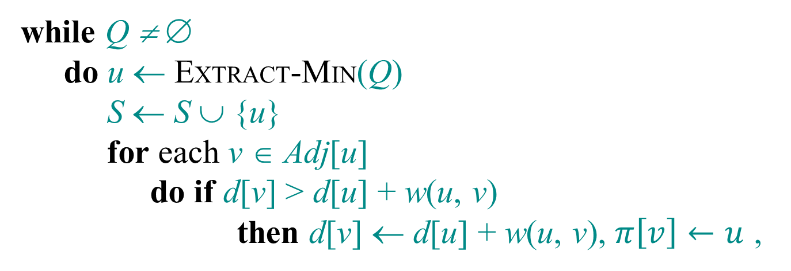
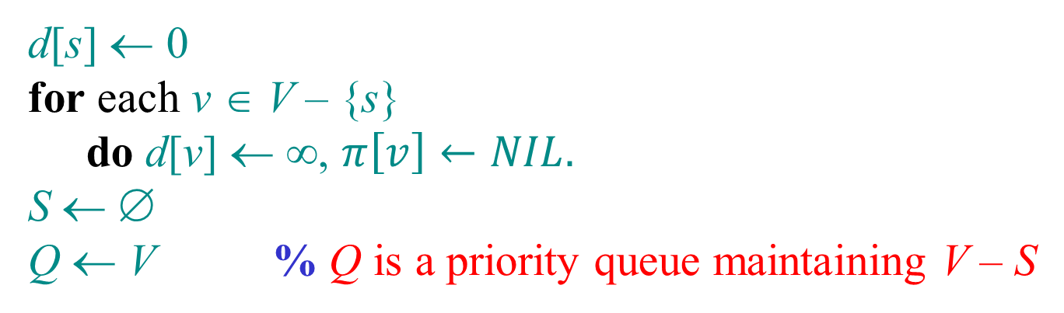
Dijkstra’s algorithm
d[s] ← 0
for each v ∈ V – {s}
do d[v] ← ∞, $π\left[v\right]←NIL.$
S ← ∅
Q ← V % Q is a priority queue maintaining V – S
while Q ≠ ∅
do u ← EXTRACT-MIN(Q)
S ← S ∪ {u}
for each v ∈ Adj[u]
do if d[v] > d[u] + w(u, v)
then d[v] ← d[u] + w(u, v), $π\left[v\right]←u$ ,
relaxation step
Implicit DECREASE-KEY

Slide 13
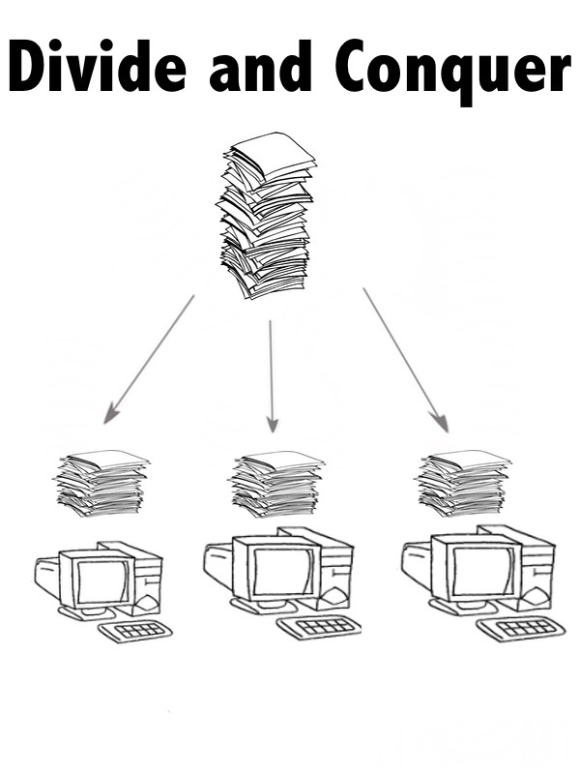

Slide 14
Merge-Sort
Merge-sort on an input sequence S with n elements consists of three steps:
Divide: partition S into two sequences S₁ and S₂ of about n/2 elements each
Recur: recursively sort S₁ and S₂
Conquer: merge S₁ and S₂ into a unique sorted sequence
Algorithm mergeSort(S)
Input sequence S with n elements
Output sequence S
if S.size() > 1
(S₁, S₂) ← partition(S, n/2)
mergeSort(S₁)
mergeSort(S₂)
S ← merge(S₁, S₂)

Slide 15
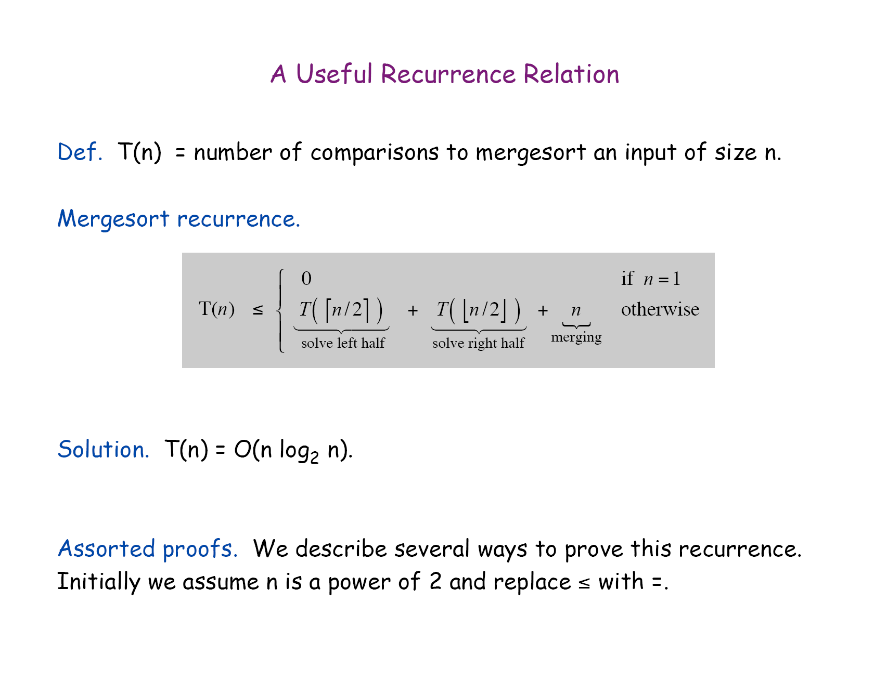

Slide 16
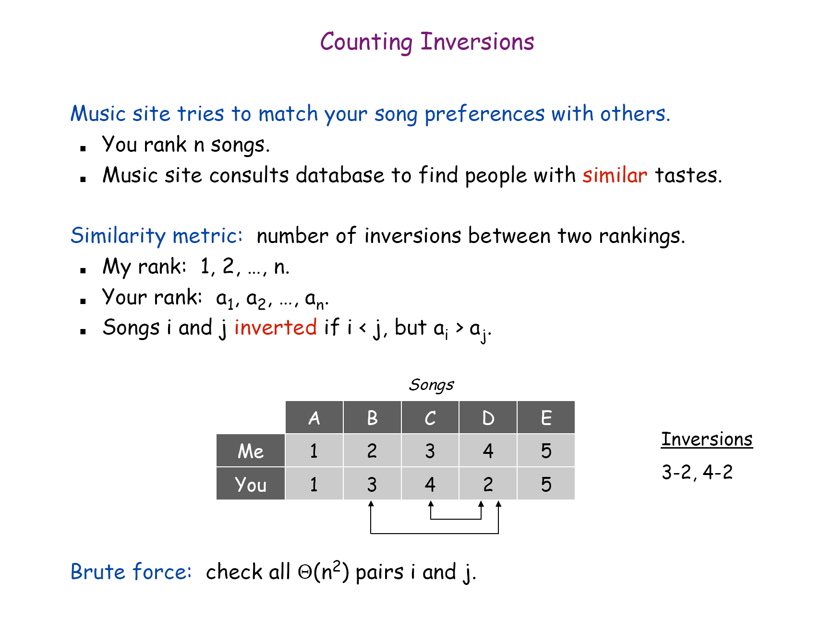

Slide 17
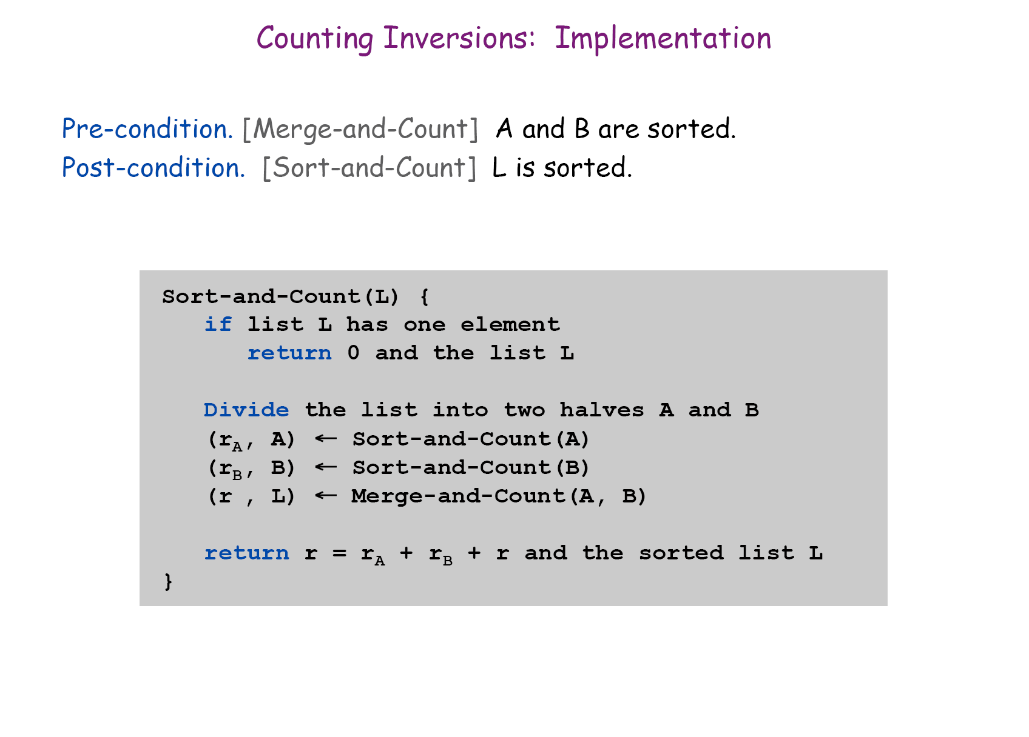

Slide 18
Dynamic Programming

Slide 19
Weighted Interval Scheduling
Weighted interval scheduling problem.
Job j starts at s_{j}, finishes at f_{j}, and has weight or value v_{j} .
Two jobs compatible if they don't overlap.
Goal: find a subset of pairwise compatible (nonoverlapping) jobs with maximal total value.
3
a
2
b
5
c
7
d
9
e
7
f
6
g
5
h
Time
0
1
2
3
4
5
6
7
8
9
10
11

Slide 20
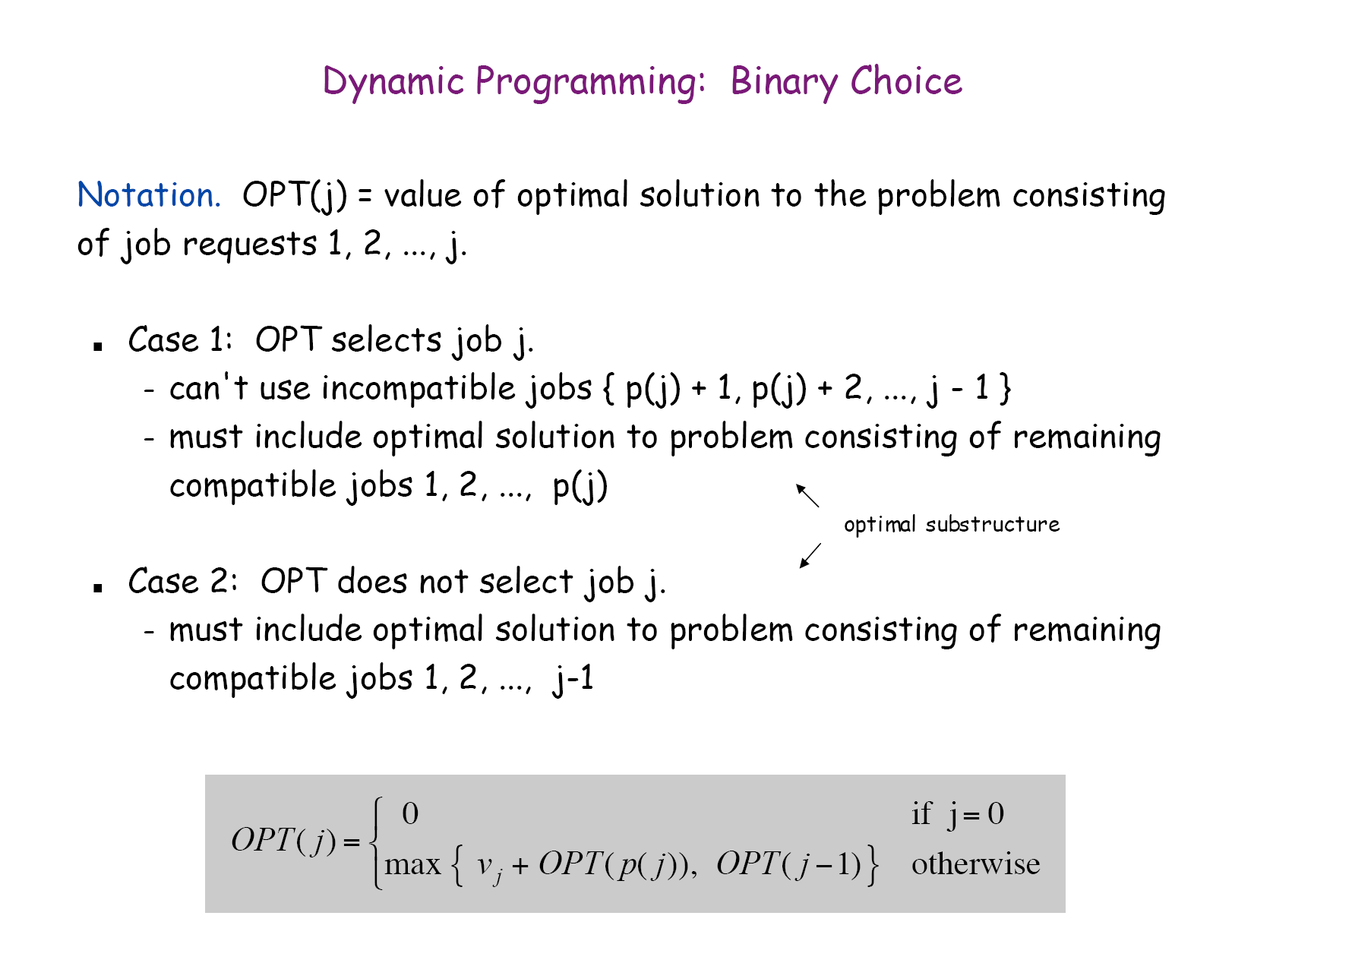

Slide 21
Weighted Interval Scheduling: Bottom-Up
Input: n, s₁, s₂, …, s_{n}, f₁, f₂, …, f_{n}, v₁, v₂, …, v_{n}
Sort jobs by finish times so that f₁≤f₂≤ … ≤f_{n}.
Compute p(1), p(2) , …, p(n)
M[0]=0;
for j = 1 to n do
M[j] = max { v_{j}+M[p(j)], M[j-1]}
if (M[j] == M[j-1]) then B[j]=0 else B[j]=1 /*for backtracking
m=n; /*** Backtracking
while ( m ≠0) { if (B[m]==1) then
print job m; m=p(m)
else
m=m-1 }
/* Memoization
B[j]=0 indicating job j is not selected.
B[j]=1 indicating job j is selected.

Slide 22
Time complexity
Sorting the jobs: O(n log n)
Computing p(): O(n) time after sorting all the jobs based on the starting times ( O (n log n) ) .
The whole loop O(n) (each pass: O(1) )
The backtracking O(n)
Time complexity: O(n log n) including sorting.

Slide 23
Manhattan Tourist Problem: Formulation
Goal: Find the longest path in a weighted grid
Input: A weighted grid G with two distinct vertices, one labeled “source” and the other labeled “sink”
Output: A longest path in G from “source” to “sink”

Slide 24
MTP: An Example
0
1
2
3
4
j coordinates
source
3
2
4
0
0
1
0
2
4
3
3
2
4
2
1
1
4
6
5
2
0
7
3
4
2
i coordinates
4
4
5
2
1
3
3
0
2
3
5
6
8
5
3
1
3
2
2
sink
4

Slide 25
MTP: Simple Recursive Program
MT(n,m)
x ← MT(n-1,m)+length of the edge from (n- 1,m) to (n,m)
y ← MT(n,m-1)+length of the edge from (n,m-1) to (n,m)
return max{x,y}
MT(n,m): the length of the optimal path from (0,0) to (n,m)

Slide 26
0-1 Knapsack Problem

Slide 27
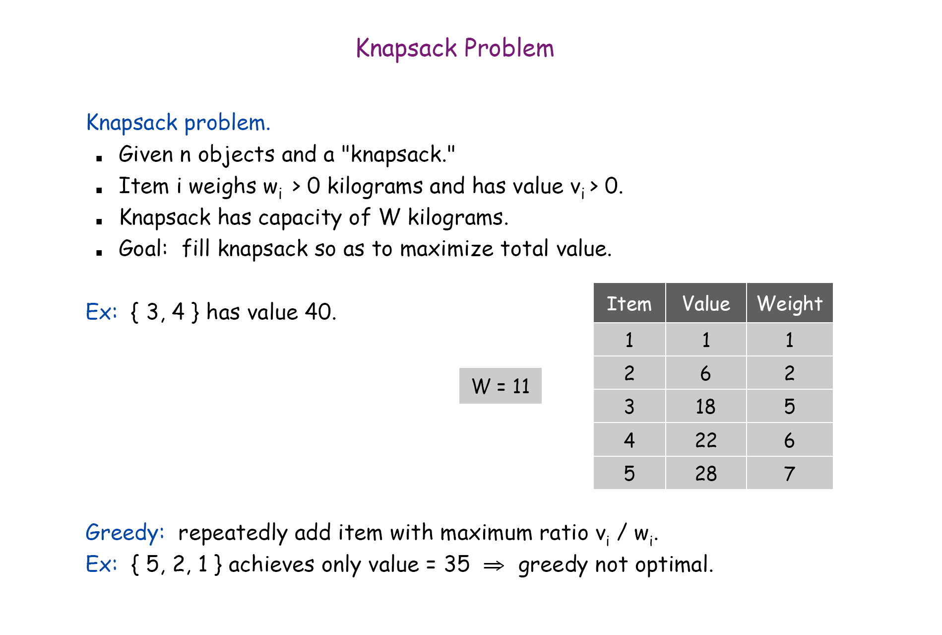
0-1 version

Slide 28
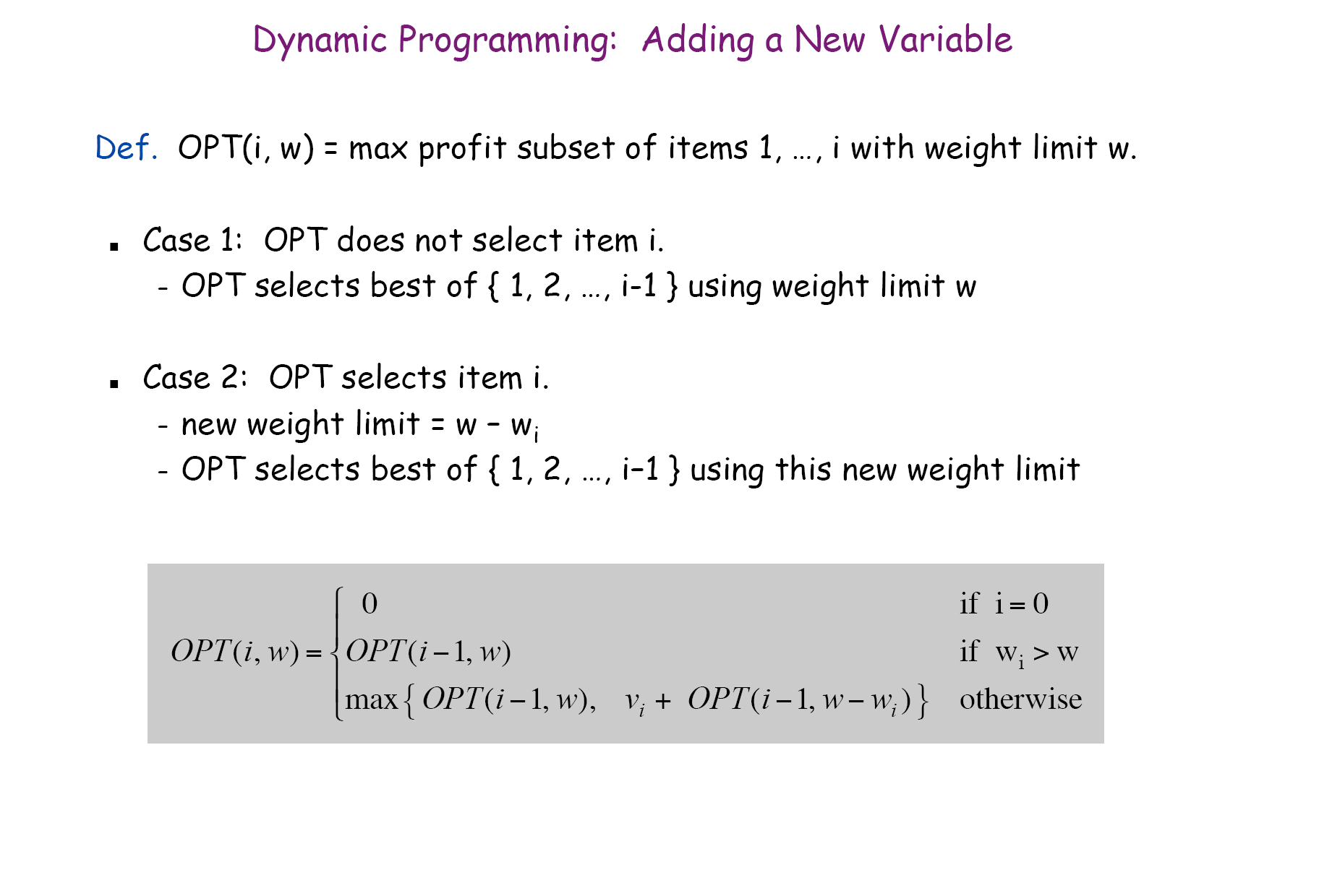

Slide 29
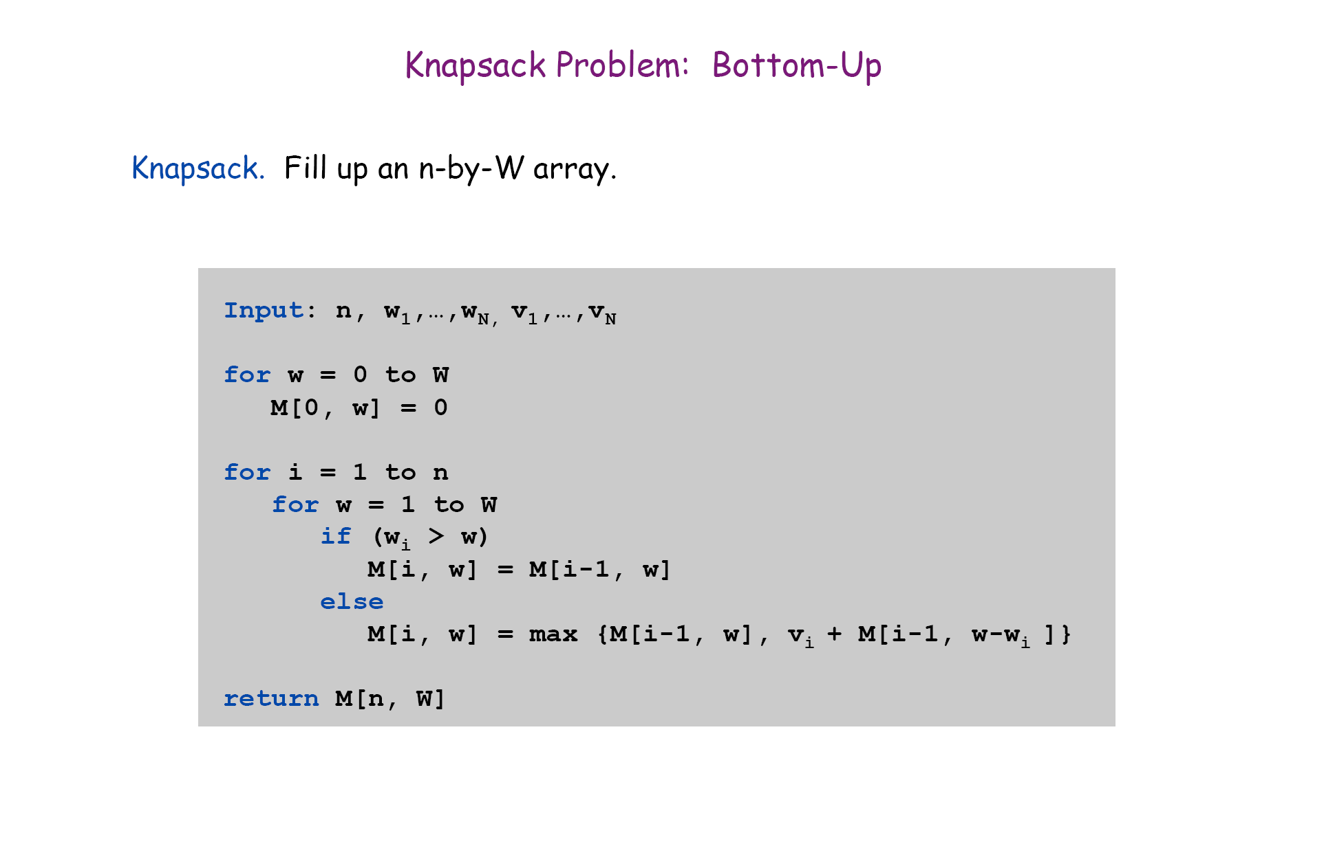

Slide 30
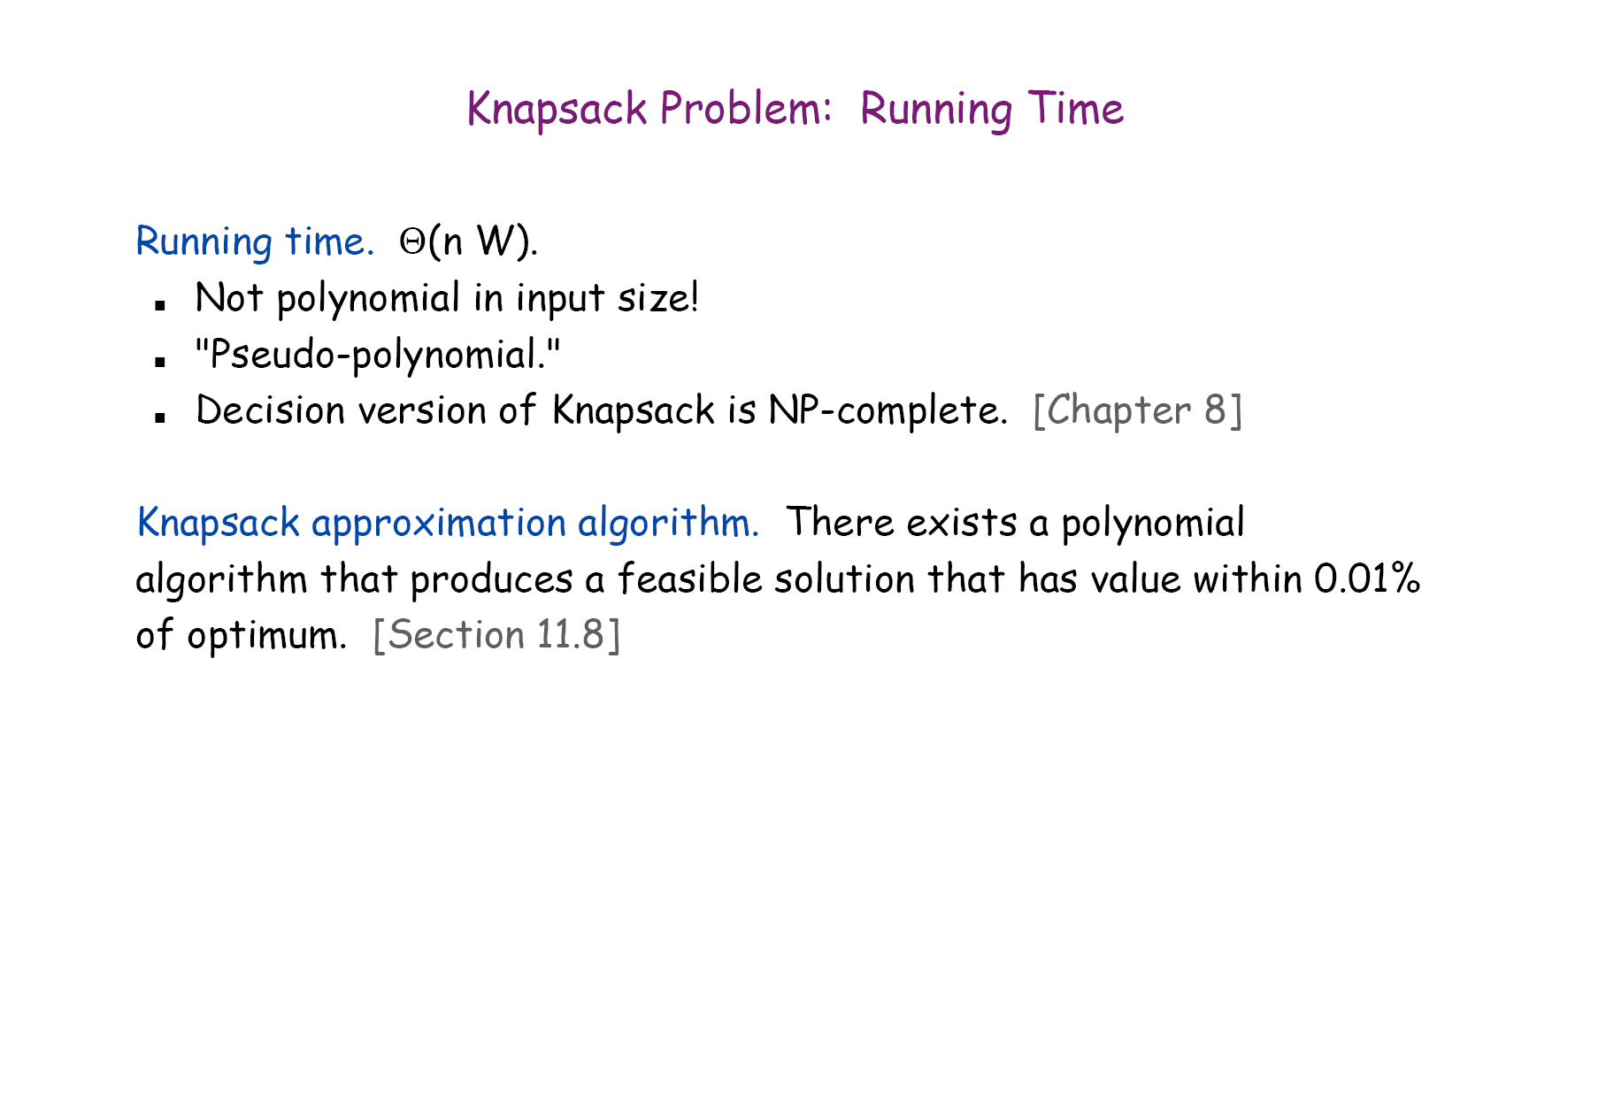

Slide 31
3. Longest common subsequence (LCS)

Slide 32
Longest common subsequence problem
Input: Two sequences X=x₁x₂...x_{m}, and
Y=y₁y₂...y_{n}.
Output: a longest common subsequence of X and Y.
A brute-force approach
Suppose that m≥n. Try all subsequence of X (There are 2^{m} subsequence of X), test if such a subsequence is also a subsequence of Y, and select the one with the longest length.

Slide 33
The recursive equation
Let c[i,j] be the length of an LCS of X[1...i] and Y[1...j].
c[i,j] can be computed as follows:
0 if i=0 or j=0,
c[i,j]= c[i-1,j-1]+1 if i,j>0 and x_{i}=y_{j},
max{c[i,j-1],c[i-1,j]} if i,j>0 and x_{i}≠y_{j}.
Computing the length of an LCS
There are n×m c[i,j]’s. So we can compute them in
a specific order.

Slide 34
The algorithm to compute an LCS
1. for i=1 to m do
2. c[i,0]=0;
3. for j=0 to n do
4. c[0,j]=0;
5. for i=1 to m do
6. for j=1 to n do
7. {
8. if x[i] ==y[j] then
9. c[i,j]=c[i-1,j-1]+1;
10 b[i,j]=1;
11. else if c[i-1,j]>=c[i,j-1] then
12. c[i,j]=c[i-1,j]
13. b[i,j]=2;
14. else c[i,j]=c[i,j-1]
15. b[i,j]=3;
14 }

Slide 35
4. Shortest common super-sequence

Slide 36
Recursive Equation:
Let c[i,j] be the length of an SCS of X[1...i] and Y[1...j].
c[i,j] can be computed as follows:
j if i=0
i if j=0,
c[i,j]= c[i-1,j-1]+1 if i,j>0 and x_{i}=y_{j},
min{c[i,j-1]+1,c[i-1,j]+1} if i,j>0 and x_{i}≠y_{j}.

Slide 37
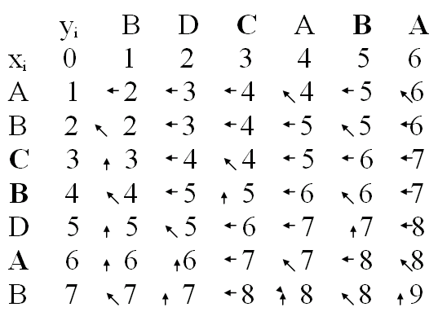

Slide 38
The pseudo-codes
for i=0 to n do
c[i, 0]=i;
for j=0 to m do
c[0,j]=j;
for i=1 to n do
for j=1 to m do
if (xi == yj) c[i ,j]= c[i-1, j-1]+1; b[i.j]=1;
else {
c[i,j]=min{c[i-1,j]+1, c[i,j-1]+1}.
if (c[i,j]=c[i-1,j]+1 then b[i,j]=2;
else b[i,j]=3;
}
p=n, q=m; / backtracking
while (p≠0 or q≠0)
{ if (b[p,q]==1) then {print x[p]; p=p-1; q=q-1}
if (b[p,q]==2) then {print x[p]; p=p-1}
if (b[p,q]==3) then {print y[q]; q=q-1}
}

Slide 39
Shortest Paths with Negative weighted edges (Bellman-Ford algorithm)

Slide 40
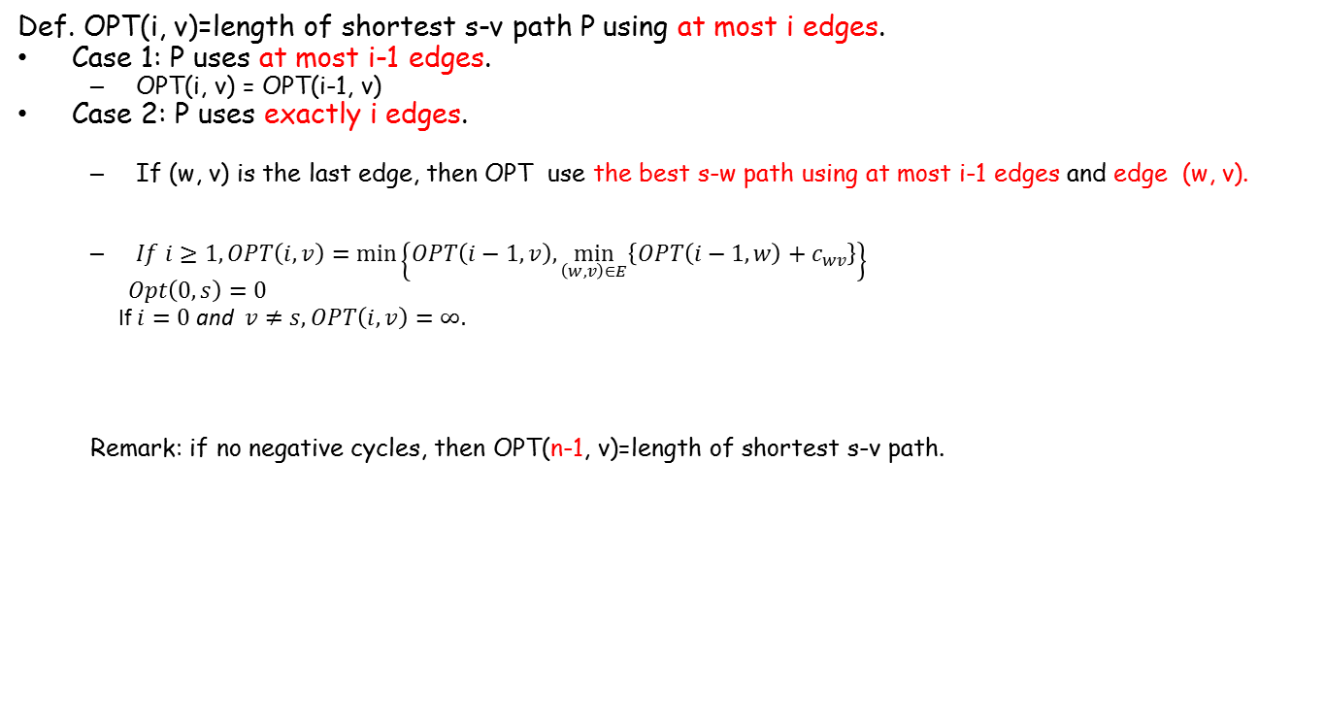
Shortest Paths: Dynamic Programming
Def. OPT(i, v)=length of shortest s-v path P using at most i edges.
Case 1: P uses at most i-1 edges.
OPT(i, v) = OPT(i-1, v)
Case 2: P uses exactly i edges.
If (w, v) is the last edge, then OPT use the best s-w path using at most i-1 edges and edge (w, v).
$If i≥1, OPT\left(i, v\right)=\min\left\{OPT\left(i−1, v\right),\min_{\left(w,v\right)∈E}\left\{OPT\left(i−1, w\right)+c_{wv}\right\}\right\}$
$$Opt\left(0, s\right)=0$$
If $i=0$ and $v≠s, OPT\left(i, v\right)=∞.$
Remark: if no negative cycles, then OPT(n-1, v)=length of shortest s-v path.
s
w
v

Slide 41
Single-Source Shortest Paths in DAGs
Shortest paths are always well-defined in DAGs
no cycles => no negative-weight cycles even if there are negative-weight edges
Idea: If we were lucky
To process vertices on each shortest path from left to right, we would be done in 1 pass

Slide 42
Single-Source Shortest Paths in DAGs
DAG-SHORTEST PATHS(G, s)
TOPOLOGICALLY-SORT the vertices of G
INIT(G, s)
for each vertex u taken in topologically sorted order do
for each v in Adj[u] do
RELAX(u, v)

Slide 43
Maximum Flow
Maximum Flow Problem
The Ford-Fulkerson method
Maximum bipartite matching

Slide 44
The basic Ford Fulkerson algorithm example of an execution
0/12
v1
v3
0/16
0/20
0/4
0/7
0/10
S
0/9
t
0/4
0/13
v2
v4
0/14

Slide 45
The Edmonds-Karp algorithm
Find the augment path using breadth-first search.
Breadth-first search gives the shortest path for graphs (Assuming the length of each edge is 1.)
Time complexity of Edmonds-Karp algorithm is O(V*E²).
The proof is very hard and is not required here.

Slide 46
Class P and Class NP
Class P contains problems which are solvable in polynomial time.
The problems have algorithms in O(n^{k}) time, where n is the input size and k is a constant.
Class NP (nondeterministic polynomial) consists of those problems that are verifiable in polynomial time.
we can verify that the solution is correct in time polynomial in the input size to the problem.
Example: Hamilton Circuit: given an order of the n distinct vertices (v₁, v₂, …, v_{n}), we can test if (v_{i}, v _{i+1}) is an edge in G for i=1, 2, …, n-1 and (v_{n}, v₁) is an edge in G in time O(n) (polynomial in the input size).

Slide 47
Some basic NP-complete problems
3-Satisfiability : Each clause contains at most three variables or their negations.
Vertex Cover: Given a graph G=(V, E), find a subset V’ of V such that for each edge (u, v) in E, at least one of u and v is in V’ and the size of V’ is minimized.
Hamilton Circuit: (definition was given before)
History: Satisfiability→3-Satisfiability→vertex cover→Hamilton circuit.
Those proofs are very hard.

Slide 48
Approximation Algorithm
An algorithm A is an approximation algorithm
if given any instance I, it finds a candidate solution s(I)
How good an approximation algorithm is?
We use performance ratio to measure the quality of an approximation algorithm.

Slide 49
Performance ratio
For minimization problem, the performance ratio r of algorithm A is defined as for any instance I of the problem,
where OPT(I) is the value of the optimal solution for instance I and A(I) is the value of the solution returned by algorithm A on instance I.

